Slide 1
TECHNICAL PRESENTATION
DATA PREPROCESSING
AND VISUALIZATION
Using Python Pandas
DSA0404:Fundamentals of data science
NAME: Sania Herbert
Reg no:192324062
GUIDED BY: DR. Krishnaraj M

Slide 2

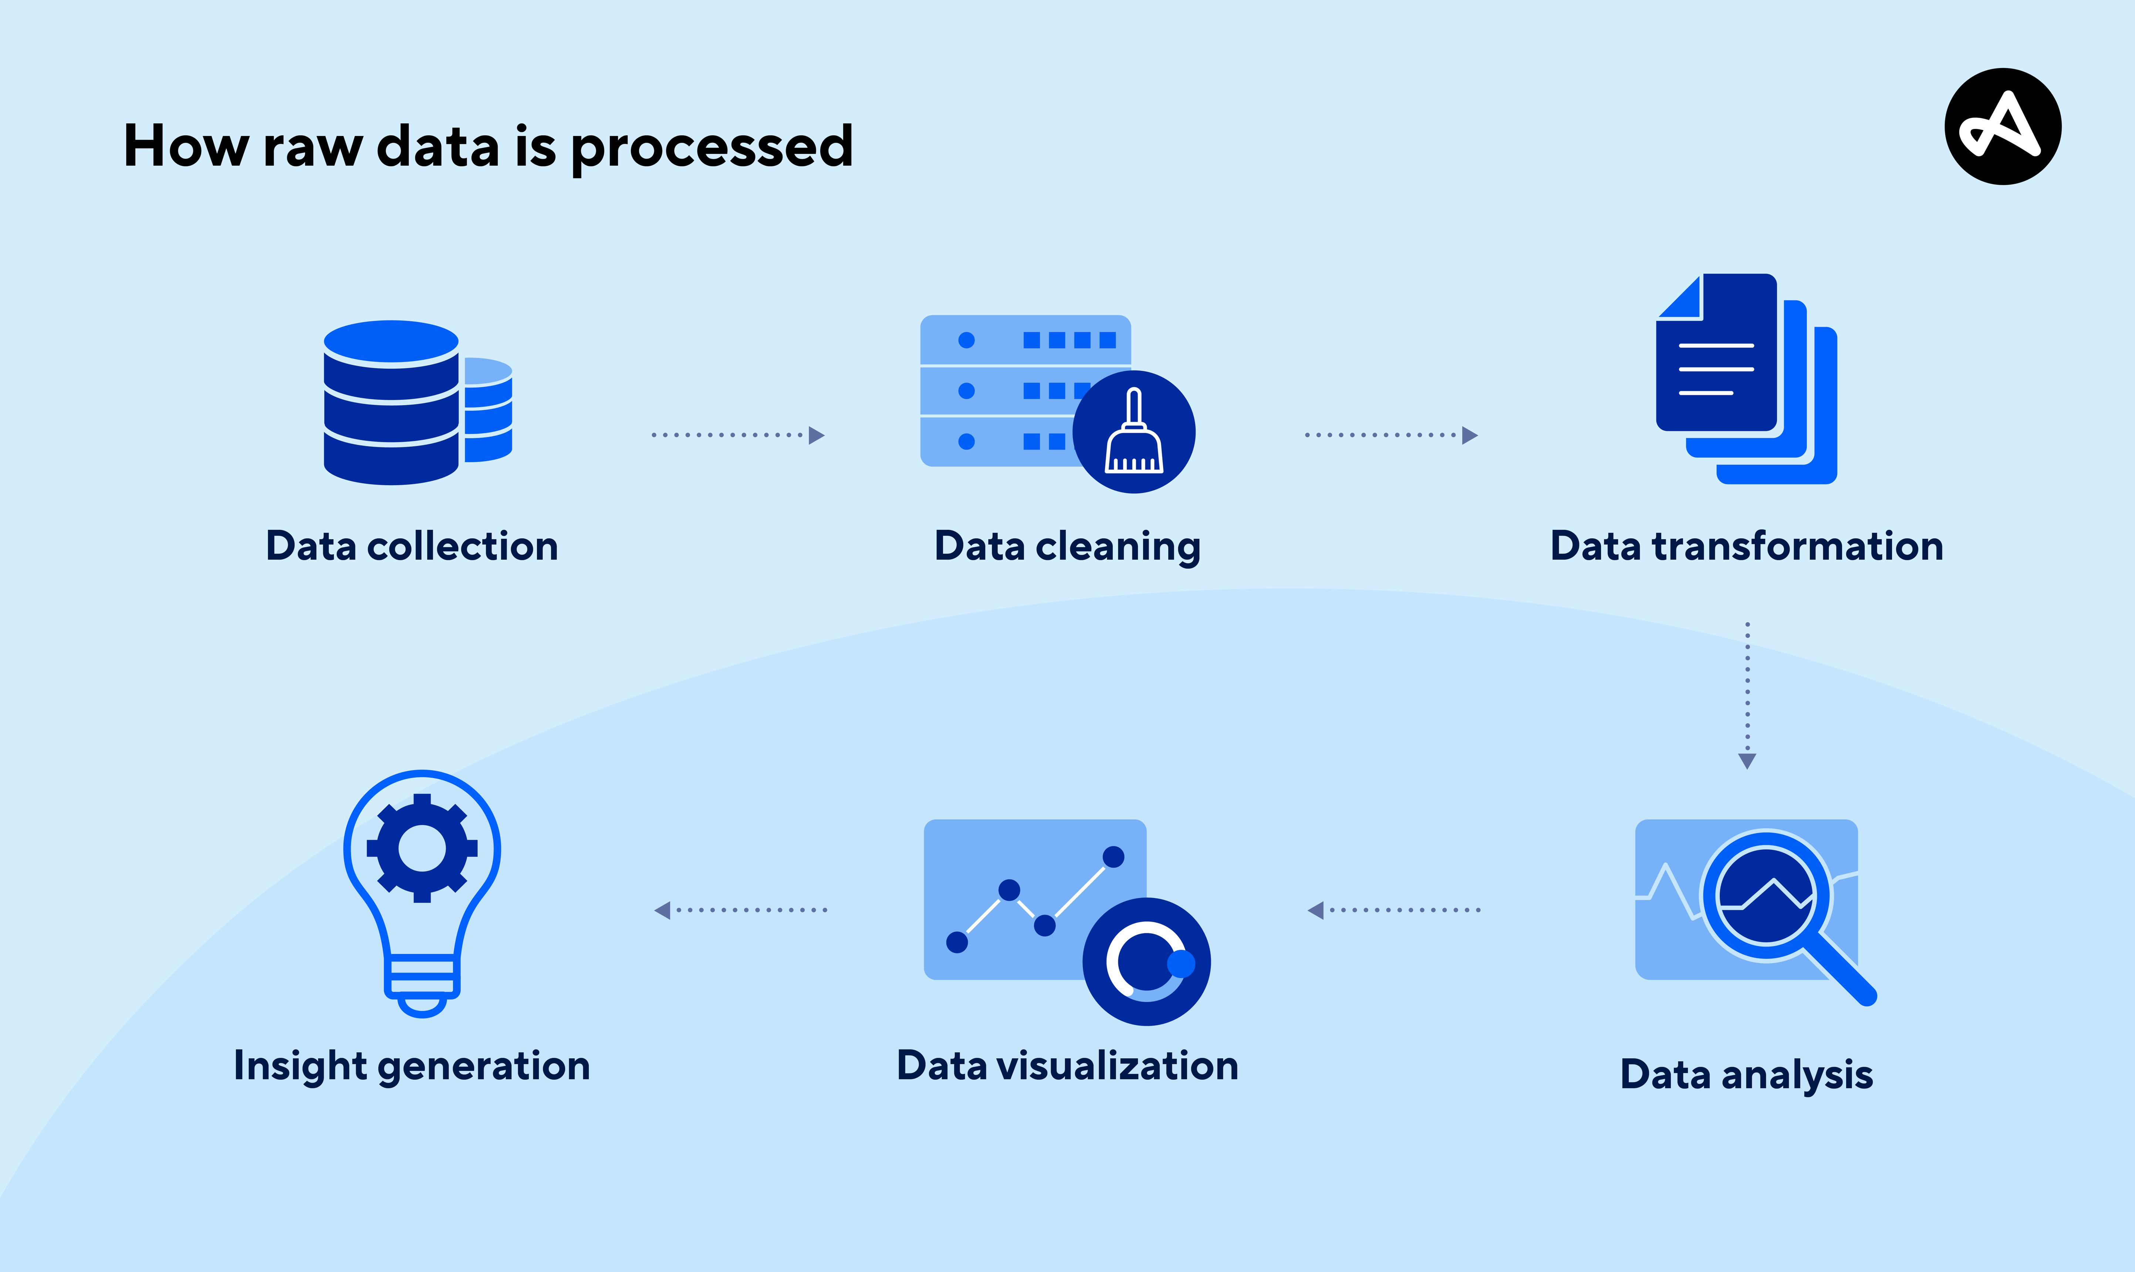
Data Preprocessing
Data preprocessing is the process of converting raw, incomplete, inconsistent, or noisy data into a clean and meaningful format before analysis or machine learning.
Real-Life Examples
Hospital patient records often contain missing ages, duplicate patient IDs, or incorrect values. Data preprocessing cleans these records before analysis.

Slide 3
Why Data Preprocessing Matters
"80% of data science time is spent on data cleaning and preparation" - Industry Standard
Critical Impact Areas:
Model Accuracy: Poor data leads to biased/inaccurate predictions
Training Efficiency: Clean data reduces computational overhead by 40-60%
Business Outcomes: High-quality insights drive decision-making
Risk Mitigation: Prevents data leakage and model failures
The Cost of Skipping:
Model fails in production, ROI loss, reputation damage

Slide 4
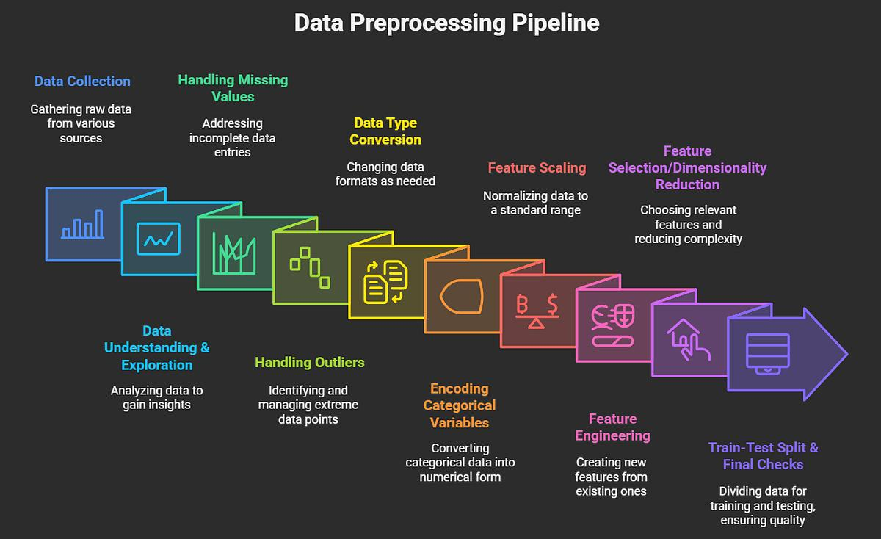
workflow

Slide 5
READING CSV FILE USING PANDAS
Reading data means importing datasets into Python for analysis.
Most real-world datasets are stored in CSV (Comma Separated Values) format.
Sample Dataset
Name Age Department Salary
Alice 25 IT 50000
Bob HR 45000
Charlie 30 IT 55000
David 28 Sales 48000
code:
import pandas as pd
df = pd.read_csv("employees.csv")
print(df.head())
output
Name Age Department Salary
0 Alice 25.0 IT 50000
1 Bob NaN HR 45000
2 Charlie 30.0 IT 55000

Slide 6
DATA SELECTION & FILTERING
Selecting only the required columns or rows from a dataset.
Selecting Columns
df["Salary"]
Selecting Multiple Columns
df[["Name","Salary"]]
Filtering Records
df[df["Salary"]>45000]
Output
Name Salary
Alice 50000
Charlie 55000
David 48000

Slide 7
HANDLING MISSING VALUES
Missing values are empty or unknown values represented by NaN (Not a Number).
Methods
Check Missing Values
df.isnull().sum()
Replace Missing Values
df.fillna(df["Age"].mean(), inplace=True)
Remove Missing Values
df.dropna()
Example
Age
25
NaN
30
Age
25
27.5
30

Slide 8
DATA CLEANING
Remove Duplicate Records
df.drop_duplicates(inplace=True)
Data cleaning removes errors from datasets.
Why?
Improves accuracy
Removes repeated records
Produces reliable analysis
Employee ID | Name | Department | Salary
101 | Alice | IT | 50000
102 | Bob | HR | 45000
103 | Charlie | IT | 55000
103 | Charlie | IT | 55000
104 | David | Sales | 48000
Employee ID | Name | Department | Salary
101 | Alice | IT | 50000
102 | Bob | HR | 45000
103 | Charlie | IT | 55000
104 | David | Sales | 48000

Slide 9
SORTING DATA
Sorting arranges data in ascending or descending order.
Why?
Finds highest and lowest values
Makes reports easier to understand
Ascending Order
df.sort_values("Salary")
Descending Order
df.sort_values("Salary", ascending=False)
Example
Before
55000 50000 45000
After
55000 50000 45000

Slide 10
GROUPING & RANKING
Grouping
Grouping combines similar records together.
Example
Department-wise Average Salary
df.groupby("Department")["Salary"].mean()
Output
Department Average Salary
HR 46000
IT 52500
Sales 48000
Ranking
Ranking assigns positions based on values.
df["Rank"]=df["Salary"].rank(ascending=False)
Output
Employee Salary Rank
Charlie 55000 1
Alice 50000 2
David 48000 3

Slide 11
FUNDAMENTAL PYTHON LIBRARIES
Library Purpose
NumPy: Numerical Computing
Pandas:Data Manipulation
SciPy:Scientific Computing
Scikit-Learn:Machine Learning
Matplotlib:Visualization
Why These Libraries?
They simplify complex data science tasks such as numerical computation, preprocessing, visualization, and machine learning.

Slide 12
NUMPY, SCIPY & SCIKIT-LEARN
NumPy
Numerical array processing.
import numpy as np
a=np.array([1,2,3])
Used for
Arrays
Matrix operations
Mathematical computations
Scikit-Learn
Machine Learning Library.
Used for
Classification
Regression
Clustering
Data Preprocessing
Model Evaluation
SciPy
Scientific Computing Library.
Used for
Statistics
Optimization
Linear Algebra
Signal Processing

Slide 13
DATA VISUALIZATION USING MATPLOTLIB
What is Data Visualization?
Presenting data graphically for easy understanding.
Why?
Detect trends
Compare values
Identify patterns
Improve decision-making
Types of Charts
Bar Chart
Line Chart
Scatter Plot
Histogram
Pie Chart
import matplotlib.pyplot as plt
plt.bar(df["Name"], df["Salary"])
plt.xlabel("Employee")
plt.ylabel("Salary")
plt.title("Employee Salary")
plt.show()
plt.bar(df["Name"], df["Salary"])
plt.plot(df["Name"], df["Salary"])
plt.scatter(df["Age"], df["Salary"])
plt.hist(df["Salary"])
plt.pie(department_count,
labels=department_count.index,
autopct="%1.1f%%")

